Slide 1

Software Engineering (CS3201) Additional material – Arch. Patterns and Estimation
Avinash

Slide 2

Architectural patterns – Microservices, Peer to Peer and Event based

Slide 3
Micro service architecture
Application consists of small, independent services that communicate with one another to get the task done
Each service is responsible for a particular function
Each service can be developed, deployed and maintained independently
Teams can work on a particular service, fix bugs, release new versions, without effecting the rest of the services
Each microservice handles one specific responsibility
Each microservice can have its own technology (programming language, DB, frameworks) different from other services
Each microservice has its own DB
Microservices communicate with one another over the network
Can scale up any service as needed (payments service can be scaled up at start of semester)

Slide 4
Micro service architecture: ex. Netflix
Key services in Netflix:
User service – manages user data, profiles and settings
Auth service – manages login, session, token validation
Content service – stores content (shows, movies) metadata/ description
Recommendation service – generates recommendations based on history
Playback service – streams video content, selects CDN nodes (CDN – Content Delivery Network, caches data to be streams over several servers, you get your data from the server nearest to you)
Billing service – handles subscriptions / payments
Search service – handles searching in content library
Notifications service – send push notifications to users
Each service is deployed independently, communicates using APIs and usually runs in containers like Docker (organized by Kubernetes)

Slide 5
Micro service architecture: ex. Netflix
How all these key services communicate?
REST APIs or gRPC
Asynchronous messaging queues (e.g., Apache Kafka)
Service Discovery with tools like Eureka
Load balancing via Ribbon
REST APIs – resources accessed and manipulated via standard HTTP protocols(GET, POST, PUT, DELETE, …)
gRPC – open-source RPC
Apache Kafka – keyword here is async, services communicate via queues, do not busy wait
Eureka – A service registry that helps discover services
Ribbon – Help balance load among several instances of a service

Slide 6
Micro service architecture: ex. Netflix
When user hits PLAY
Auth Service - checks if you're logged in and have access.
User Service - loads your profile.
Content Service - fetches movie metadata.
Recommendation Service - tweaks the interface.
Playback Service - starts streaming from the closest server (CDN).
Rating Service - tracks what you watch and how you rate it later.
Analytics/Logging Services - track your interaction for future improvement.

Slide 7
Peer to Peer Architecture
Decentralized network architecture (as opposed to Client-Server)
Consists of computers, called peers, where each computer has equal status and can act as both client and server
Every peer can request for resources and provide resources
No central server controlling network, peers communicate directly with one another (instead of having to communicate via server)
Main features:
Decentralized
Equal roles /capabilities
Resource sharing: by product of decentralization
Scalability

Slide 8
Peer to Peer: example Bit torrent (file sharing)
Imagine you want to download a movie using torrents
Download a .torrent file or using magnet link
This file contains metadata (file name, structure, tracker info)
Tracker - a lightweight server that helps a peer find other peers who have the file or parts of it
The peer then connects to one or more peers who have the file
Types of peers – seeders (who have the complete file), and leechers (who have some parts of the file – they are probably downloading at this point)
The peer downloads from several other peers simultaneously
The parts of file you download, you start uploading them to others in need
Once you have completed downloading, your entire file is ready, and you continue uploading file parts to others who need

Slide 9
Peer to Peer: example Bit torrent (file sharing)
Roles
Peer (network participant)
Seeder
Leecher
Tracker (keeps track of peers sharing the same file)
Advantages of P2P
High speeds (multiple sources)
No central server (one point of attack/ vulnerability/ power-authority)
Efficient
Scalable
Disadvantages
No guaranteed uptime / availability (peers can go offline anytime)

Slide 10
Event based Architecture
Listener pattern (or observer pattern) is an example of event-based architecture – recall last class (Lec 9.1)

Slide 11
Software cost estimation - COCOMO

Slide 12
COCOMO (Hans Van Vliet, pg. 155)
COnstructive COst MOdel (COCOMO) is one of the best documented algorithmic cost estimation models
Simplest form – Basic COCOMO, a formula that relates effort (cost) to software size
E = bKLOC^{c}
where b and c are constants that depend on the kind of project being executed
COCOMO distinguishes three classes of projects:
Organic – small team, good experience, known environment and seldom large projects
Embedded – inflexible environment, many constraints, large project
Semidetached – experienced and inexperienced people, semi large project

Slide 13
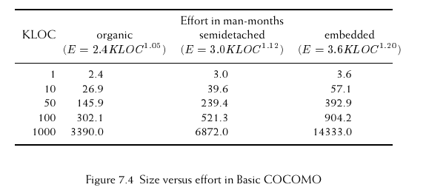
COCOMO
Parameters for the three project types:
organic: b = 2.4, c = 1.05
semidetached: b = 3.0, c = 1.12
embedded: b = 3.6, c = 1.20
Example of estimation:
Here, one man-month is an
estimate of effort, and
equals effort of one man
for a month

Slide 14
Intermediate and Detailed COCOMO
Advanced COCOMO models that take into account 15 cost drivers – attributes that effect productivity, and hence cost
These models add a multiplicative correction factor to effort estimate
These models use a value of b slightly different from basic COCOMO
Suppose we find a nominal effort of basic COCOMO as 40 man-months, but complexity of the software is low, a multiplicative factor of 0.85 can be considered, and therefore correct the man-months as 0.85 * 40 = 34 months
You may consider Basic COCOMO to generate nominal values of effort

Slide 15
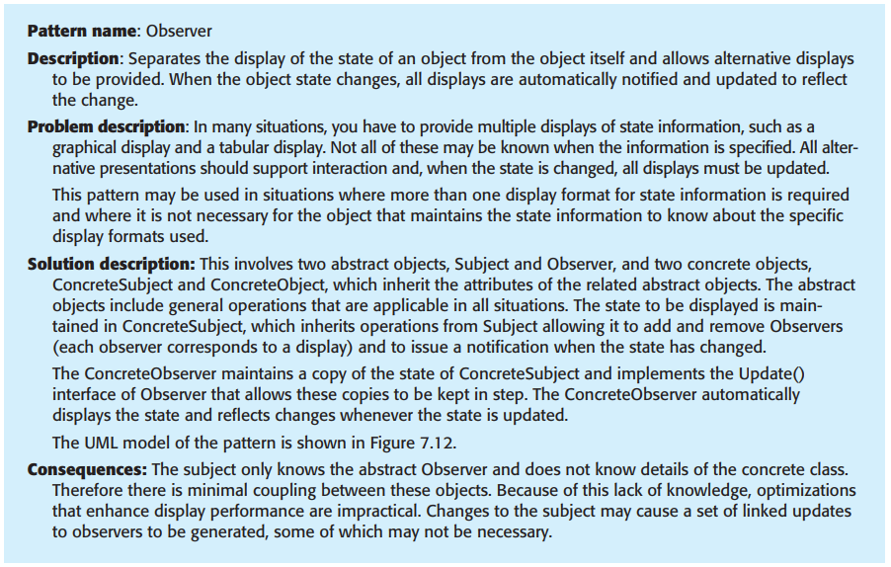
Design Patterns: Sample

Slide 16
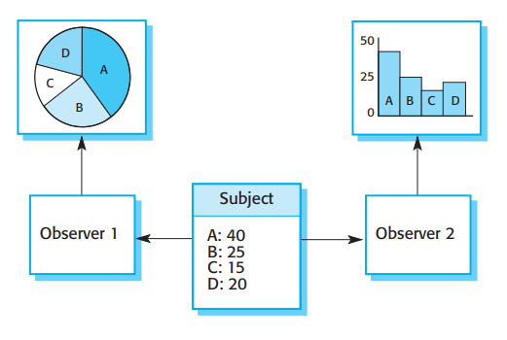
Design Patterns: Sample

Slide 17
Difference between design and arch. pattern?
Feature | Design Pattern | Architecture Pattern
Scope | Local (class / module) | Global (application/ system)
Abstraction | Lower | Higher
Focus | Object creation, interaction | Application structure and data flow between components
Examples | Observer, Singleton, etc. | MVC, microservices, Layered

Slide 18
Implementation Issues

Slide 19
Implementation Issues
Reuse
Configuration Management
Host-target development

Slide 20
Open-source Development

